Slide 1

Creating Infographics
With Business Analyst
Reina Chano Murray
JHU Data Services

Slide 3
Agenda
What is Business Analyst?
What data is available? (Esri Demographics)
How do I start? (demonstrations)
Questions

Slide 4
What is Business Analyst?

Slide 5
What is it?
Part of Esri’s suite of geospatial tools
Available as a web app*, desktop/enterprise software, mobile app
Provides easy access to location-based demographic, marketing, and business data
Designed for both data analysis and data visualization
*accessible as part of ArcGIS Online, Esri web GIS platform
Notes:
Esri – leading commercial provider of GIS software and services
GIS – geographic information systems

Slide 6
What do I use it for?
Create Maps
Create color-coded maps visualizing various commercial and public data
Search for and map points of interest based on name, NAICS or SICS code
Build Infographics
Use templates or build your own to visualize key indicators for an area*
Build Reports
Use templates or build your own to download key indicators for an area* in pdf or excel format
Analyze Locations
Perform a suitability analysis (identify sites that meet your defined criteria)
Perform a void analysis (detect voids and gaps in specific businesses and services)
Create a threshold area (create a ring that meets a specified variable)
*such as a point (store location), a boundary (neighborhood), or a buffer (5-mile radius from a point)

Slide 7
Sample Use Cases
I want to…
create a map showing city precinct boundaries, color-coded by the percent of the population who are 18+, overlaid with the location of polling stations in Baltimore, MD.
create a visual of the consumer spending habits of people living within a 5, 10 and 15 minute walk of a potential grocery store location.
download a spreadsheet on educational attainment metrics for a neighborhood to conduct further analysis in R or Excel.
perform a void analysis to determine where there is a lack of medical care facilities in a region of Baltimore, MD.

Slide 8
What Data is Available?

Slide 9
Esri Demographics Data
A global collection of authoritative demographic data for over 150 countries and regions
Data sources include government sources (ie: US Census Bureau), as well as commercial datasets (ie: Infogroup, DataAxle)
Thousands of attributes describing geographic areas across the world at multiple levels of geography
Regularly updated with the latest available data*
*when a dataset is updated, the older version of that dataset will often become unavailable via Business Analyst, and can only be purchased from Esri for a fee.

Slide 10
Esri Demographics Data
Examine data via Esri’s Data Browser and documentation pages
https://bit.ly/esri_databrowser

Slide 11
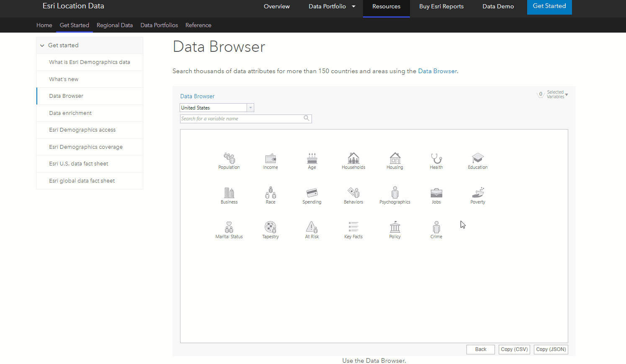

Slide 12
How do I start? Demo time!

Slide 13
Demonstration
What We’ll Cover
How to access Business Analyst Online (BAO)
Create a quick color coded map
Adding layers/data from ArcGIS Online
Adding data directly in BAO
Creating a report
Creating an infographic
Accessing tutorials

Slide 14
Demonstration Topic
Health Insurance Coverage – or lack thereof – and medical care:
Create map – 2020 Pop65+ with no health insurance
Add layers from ArcGIS Online:
primary care clinics service uninsured persons
Baltimore city neighborhoods
Create report for a neighborhood
Create 5,10,15 minute walk buffers around clinics
Run a comparison
Create an infographic
Build a custom infographic
Datasets are available in: https://gisanddata.maps.arcgis.com/home/group.html?id=0cf602de3dfb425ba0a3236eea11a529

Slide 15
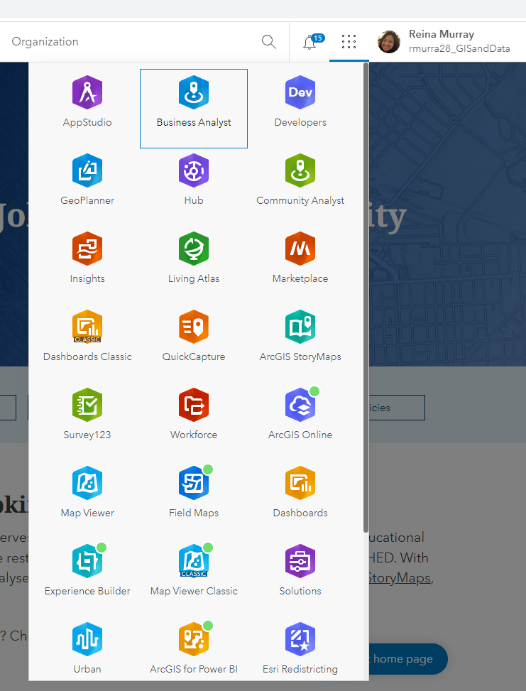
How do I access it?
Business Analyst is accessed through JHU’s ArcGIS Online organization
As long as you have an active and valid JHED, you have access to JHU’s suite of Esri software and web applications
See https://guides.library.jhu.edu/gis

Slide 16
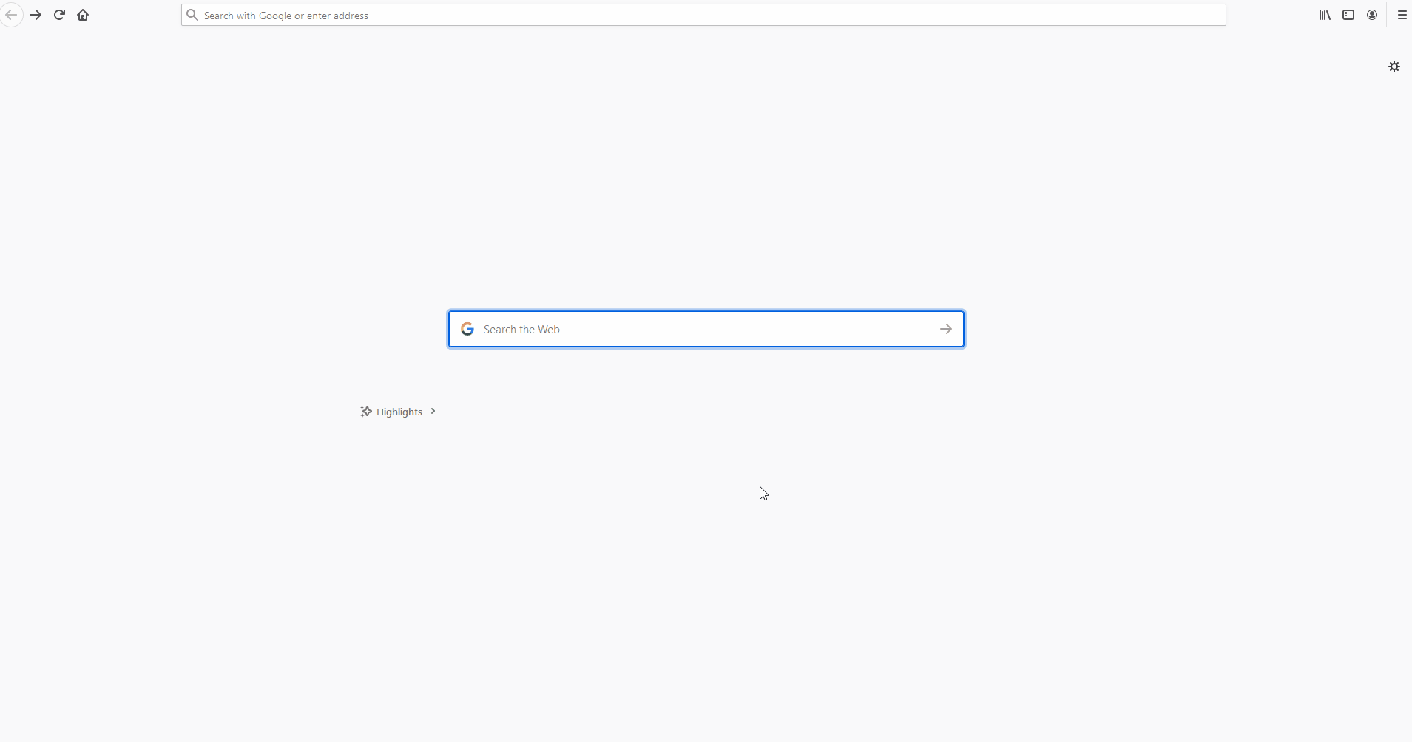

Slide 17

Fall 2022 Data Bytes Schedule
GIS and Maps
Programming
All sessions are on Mondays from 12 to 1 pm.
Finding Maps and Map Data
Speeding up your Python Code
More info at: bit.ly/data-bytes
Sept 12th
Oct 10th
Choosing a Python IDE
Introduction to Leaflet
Sept 19th
Oct 17th
Thank you
for attending!
Please complete our survey at:
bit.ly/data-bytes-survey
Creating Infographics in
Business Analyst
Advanced StoryMaps
Tips and Tricks
Sept 26th
Oct 24th
Debugging your Python Code
Introduction to APIs in R
Oct 3rd
Oct 31st

Slide 18
Questions?

